Slide 1
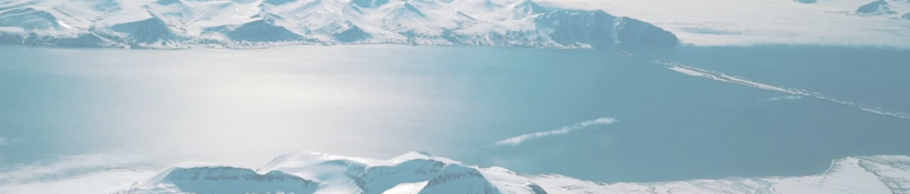
Statoil/C-CORE Iceberg Classification Challenge
Ismael Martinez
Learn Data Science Meetup
February 22, 2018
3343 Teams Prize Money: $25K/$15K/$10K
Ended January 23rd, 2018

Slide 2
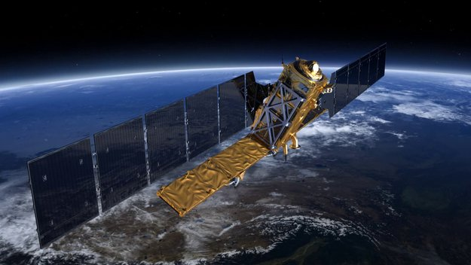
Motivation
Motivation
Statoil is an international energy company which provides gas, oil and wind power from ocean mining
C-CORE is a satellite R&D corporation which uses computer vision based surveillance
Statoil and C-CORE are looking for a new computer vision algorithm to identify icebergs using satellite radar in current and future mining areas
Is a spotted object a ship, or an iceberg?

Slide 3
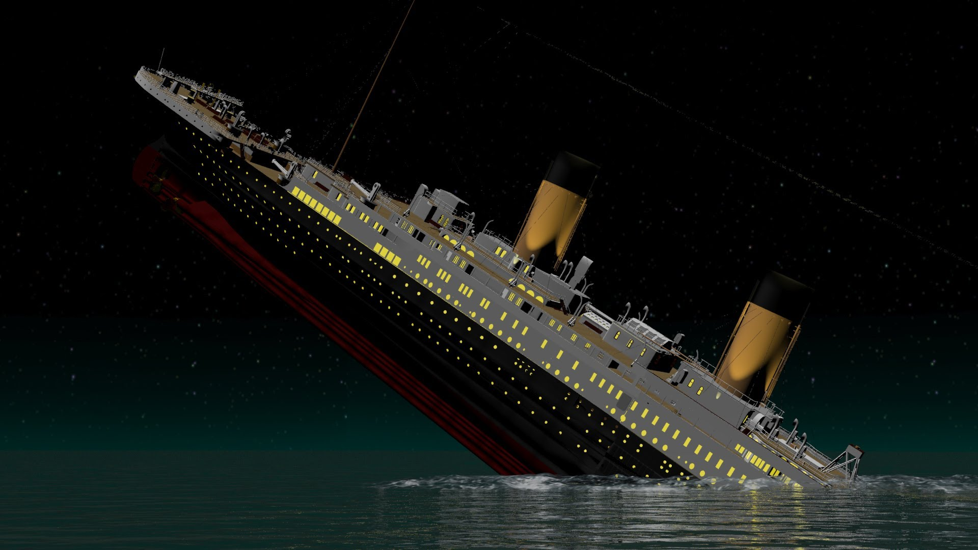
“Drifting icebergs present threats to navigation and activities in areas […] offshore”
-Kaggle

Slide 4
Background
Background
Background
Images taken from Sentinel-1 600km above Earth
Uses C-Band radar – bounces energy signal off object and records the echo
Solid objects appear as bright spots - reflects more radar energy than surrounding
High and low winds can create lighter and darker images respectively
Notes:
Reflected energy is known as backscatter

Slide 5
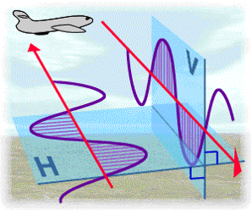
HH and HV
HH and HV
HH and HV
Radar is always emitted horizontally, received both horizontally and vertically.
HH: Transmitted horizontally, received horizontally
HV: Transmitted horizontally, received vertically
Notes:
Always emitted horizontally, received both

Slide 6
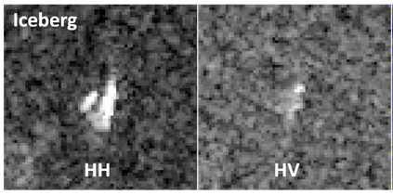
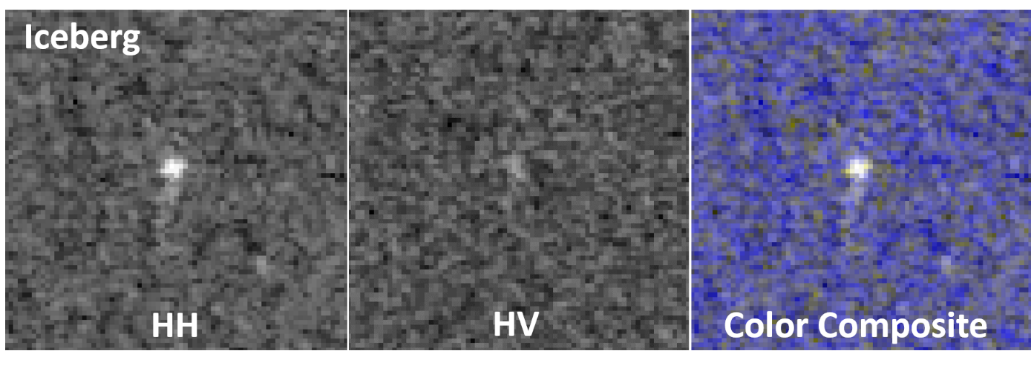
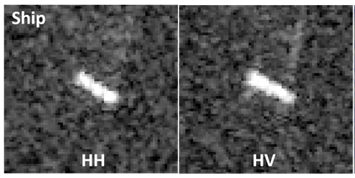
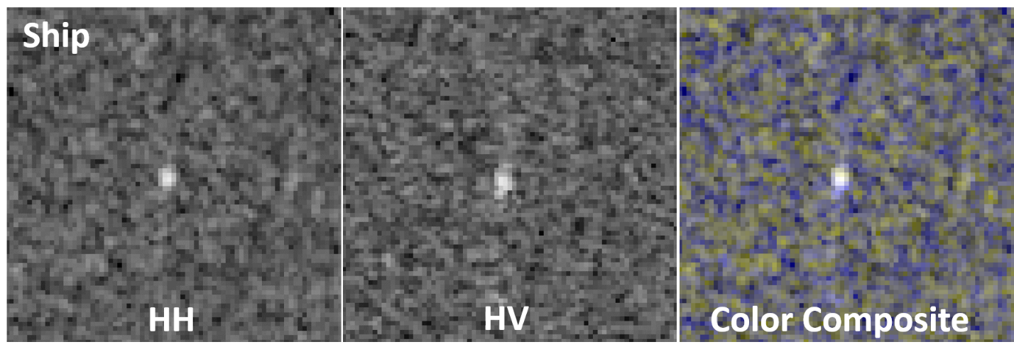
HH and HV
HH and HV

Slide 7
HH and HV
HH and HV
Each image given is 75x75 pixels
Values are floating point numbers representing dB
Could be negative

Slide 8
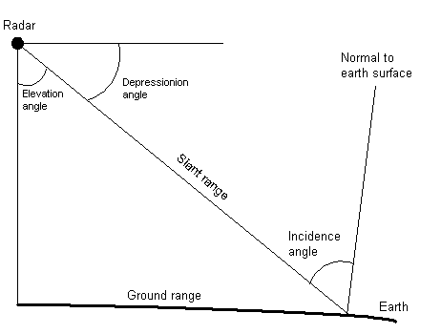
Incidence Angle
Incidence Angle
Angle between incoming signal and surface normal vector at the point of ground contact.

Slide 9
Data
Data
Band1 and Band2: HH and HV, 75x75 images
Incidence Angle (some ‘na’s in training set)
Image ID
is_iceberg (0 or 1) - Target

Slide 10
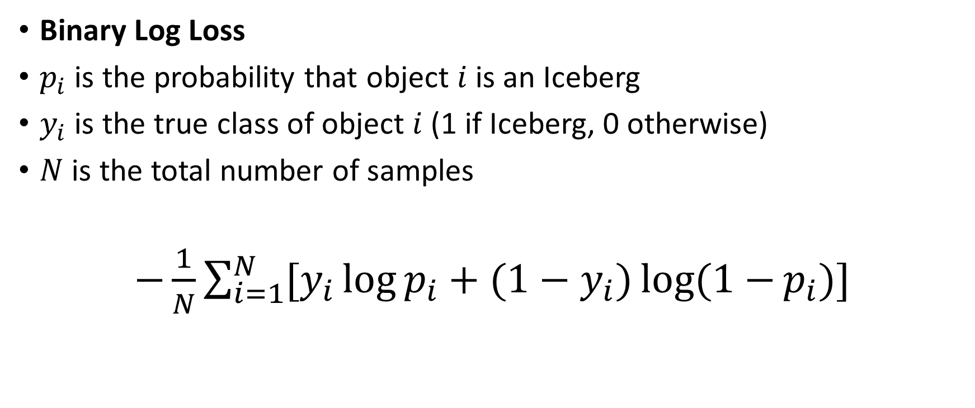
Evaluation – Binary Log Loss
Evaluation – Binary Log Loss
Binary Log Loss
$p_{i}$ is the probability that object $i$ is an Iceberg
$y_{i}$ is the true class of object $i$ (1 if Iceberg, 0 otherwise)
$N$ is the total number of samples
$−\frac{1}{N}\sum_{i=1}^{N}{[y_{i}\log{p_{i}}+(1−y_{i})log(1−{p_{i})}]}$

Slide 11
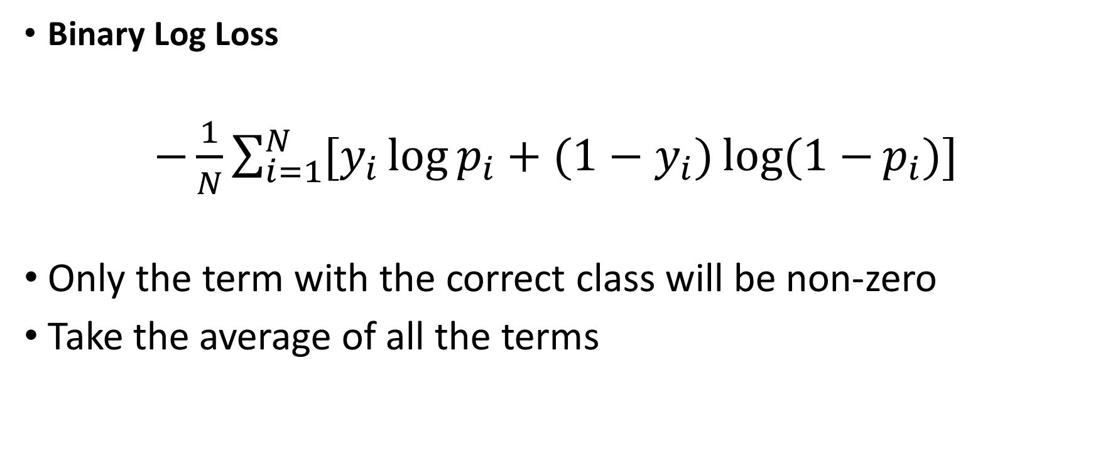
Evaluation – Binary Log Loss
Evaluation – Binary Log Loss
Binary Log Loss
$−\frac{1}{N}\sum_{i=1}^{N}{[y_{i}\log{p_{i}}+(1−y_{i})log(1−{p_{i})}]}$
Only the term with the correct class will be non-zero
Take the average of all the terms

Slide 12
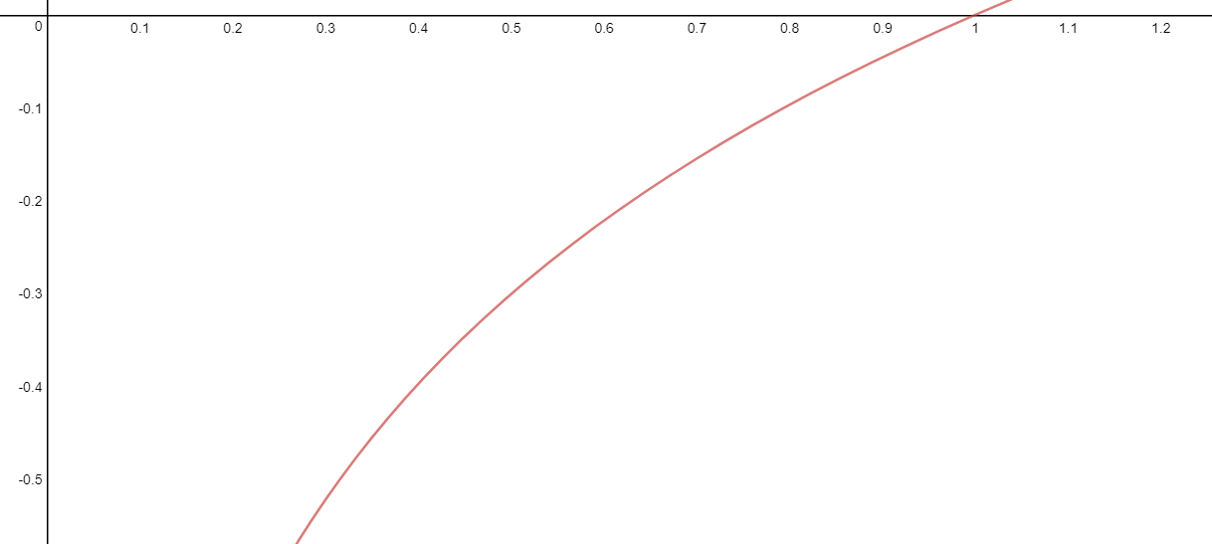
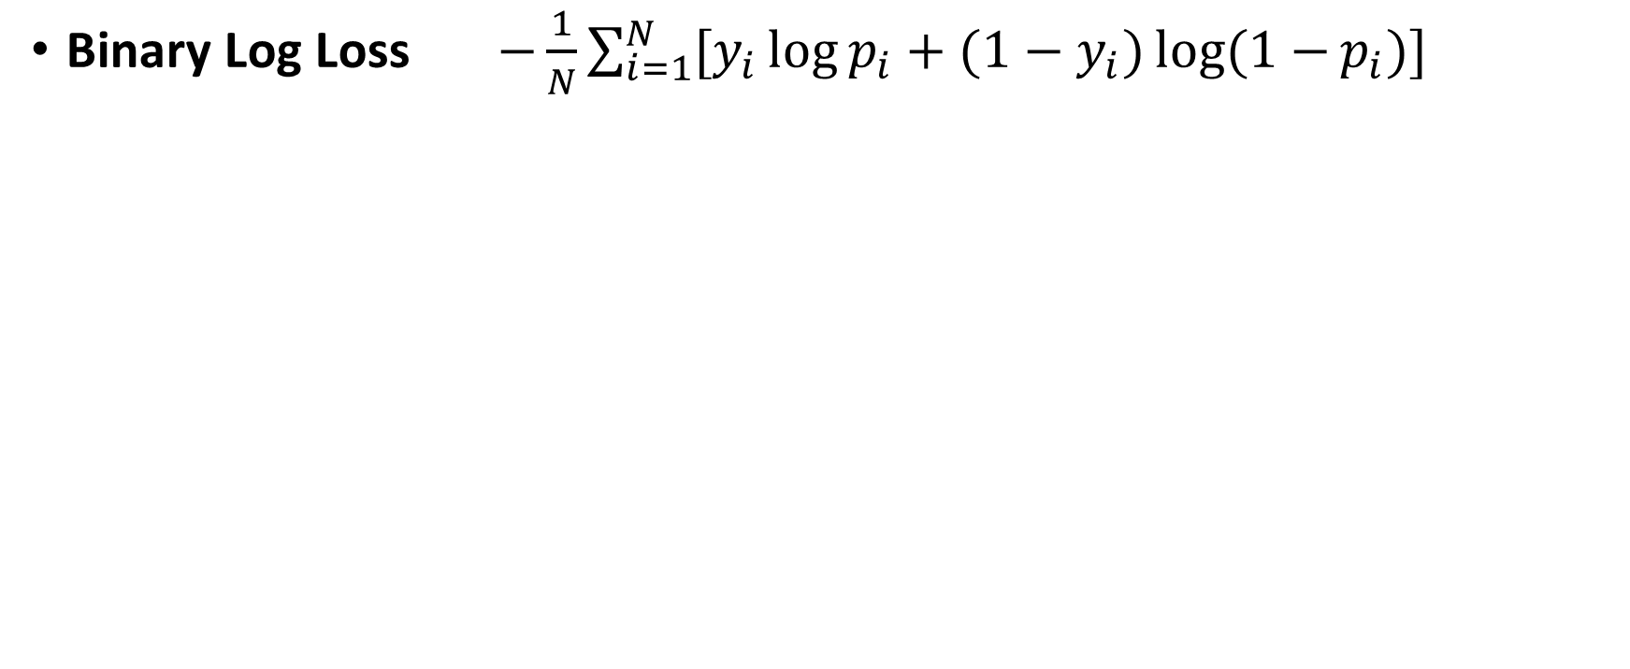
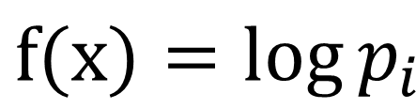
Evaluation – Binary Log Loss
Evaluation – Binary Log Loss
Binary Log Loss $−\frac{1}{N}\sum_{i=1}^{N}{[y_{i}\log{p_{i}}+(1−y_{i})log(1−{p_{i})}]}$
$$f(x)=log{p_{i}}$$

Slide 13
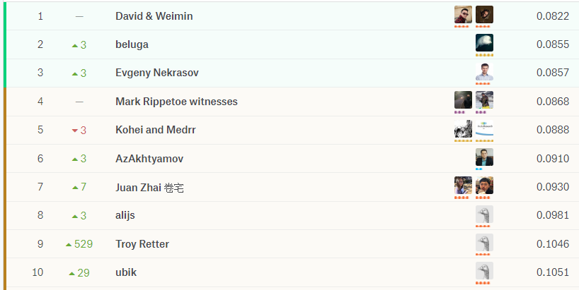
Leaderboard
Leaderboard

Slide 14
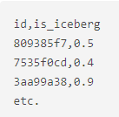
Competition Goal and Submission
Competition Goal and Submission
Goal: Determine if an image contains an iceberg or not
Submission:
id – Image ID
is_iceberg – the probability that an object is an Iceberg
No more than two submissions per day
May select up to two final submissions for judging
Notes:
Recap

Slide 15
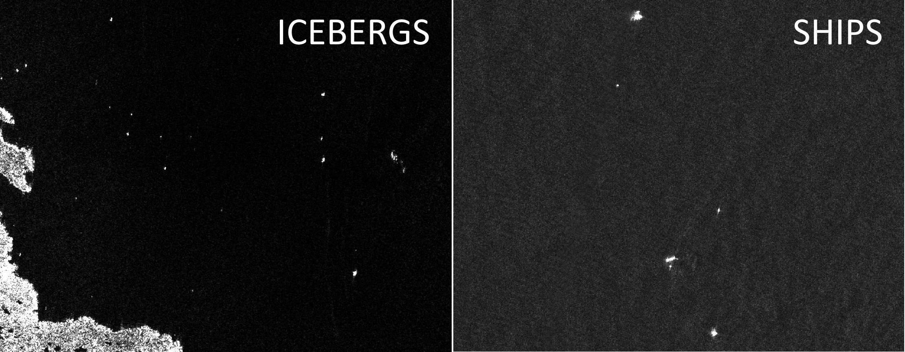
Data Leak!
Data Leak!
Same incidence angles result in same objects
Many people took advantage of this leak with decent results

Slide 16
Nearest Neighbours
Nearest Neighbours
Cluster the test data based on inc_angle
Objects within a certain radius (inc_angle) of each other are likely to be the same
New Feature!

Slide 17
Common Approaches
Common Approaches
Convolutional Neural Networks (CNN)
Boosting (XGBoost and LightGBM)
Choosing models based on K-Fold Cross Validation
Ensembling and K-Fold Stacking
KNN Regressors on inc_angle
Not using inc_angle at all
Notes:
Stacking
0.75 -> 1 and 0.05 -> 0.00001
KNN
XGB and LightGBM
VGG

Slide 18
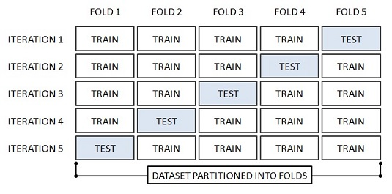
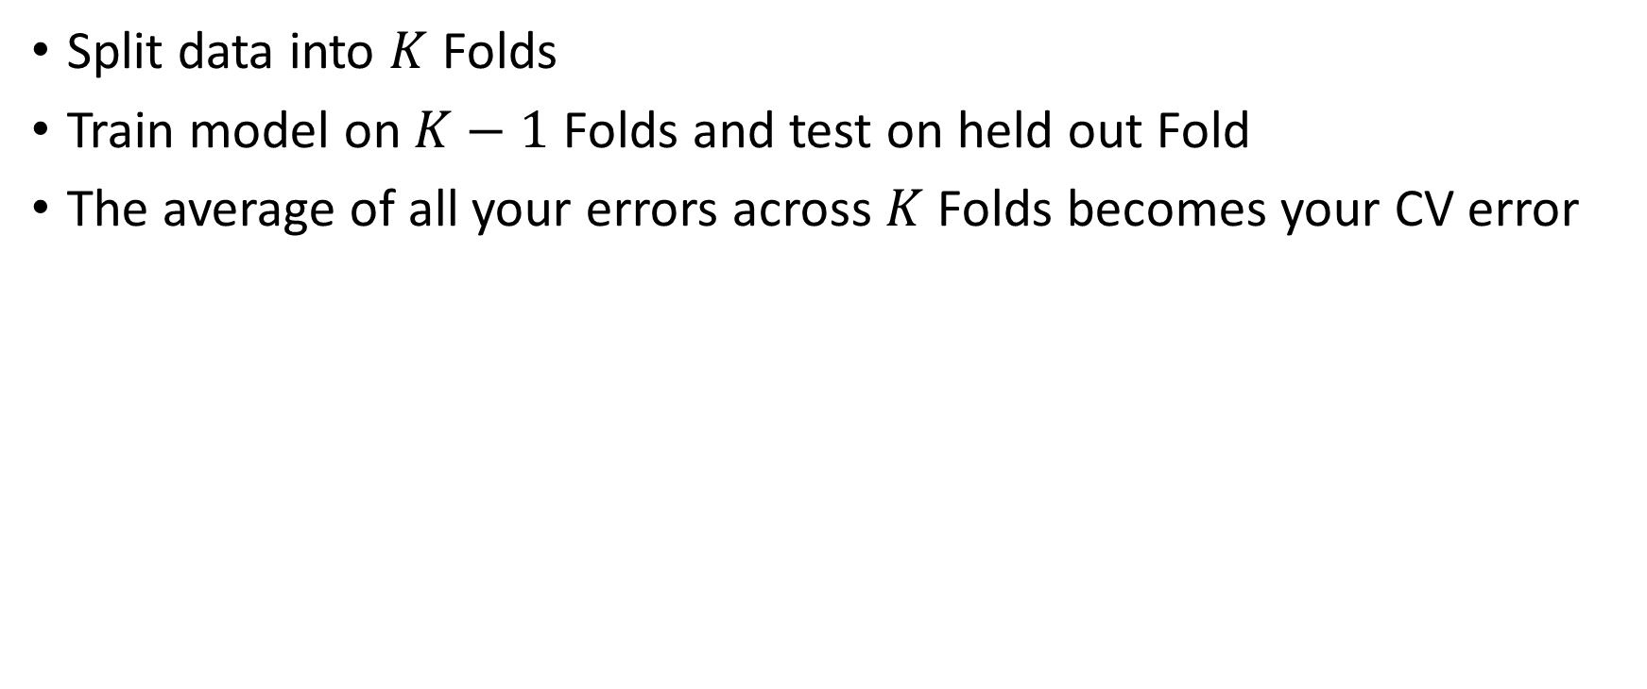
K-Fold Cross Validation
K-Fold Cross Validation
Split data into $K$ Folds
Train model on $K−1$ Folds and test on held out Fold
The average of all your errors across $K$ Folds becomes your CV error

Slide 19
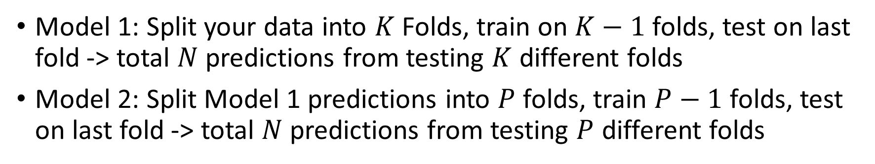
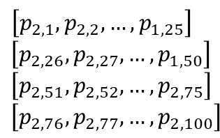
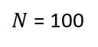
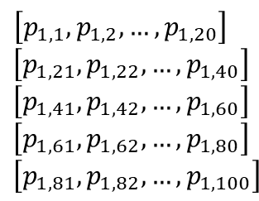
K-Fold Stacking
K-Fold Stacking
Model 1: Split your data into $K$ Folds, train on $K−1$ folds, test on last fold -> total $N$ predictions from testing $K$ different folds
Model 2: Split Model 1 predictions into $P$ folds, train $P−1$ folds, test on last fold -> total $N$ predictions from testing $P$ different folds
1
$$\left[p_{1,1}, p_{1,2},…,p_{1,20}\right]$$
$$\left[p_{1,21}, p_{1,22},…,p_{1,40}\right]$$
$$\left[p_{1,41}, p_{1,42},…,p_{1,60}\right]$$
$$\left[p_{1,61}, p_{1,62},…,p_{1,80}\right]$$
$$\left[p_{1,81}, p_{1,82},…,p_{1,100}\right]$$
1
2
$$\left[p_{2,1}, p_{2,2},…,p_{1,25}\right]$$
$$\left[p_{2,26}, p_{2,27},…,p_{1,50}\right]$$
$$\left[p_{2,51}, p_{2,52},…,p_{2,75}\right]$$
$$\left[p_{2,76}, p_{2,77},…,p_{2,100}\right]$$
Model 1
2
Model 2
3
3
4
Train on folds 1-4, test on fold 5.
Repeat with each fold out.
4
Train on folds 1-3, test on fold 4.
Repeat with each fold out.
5
$N$ = 100

Slide 20
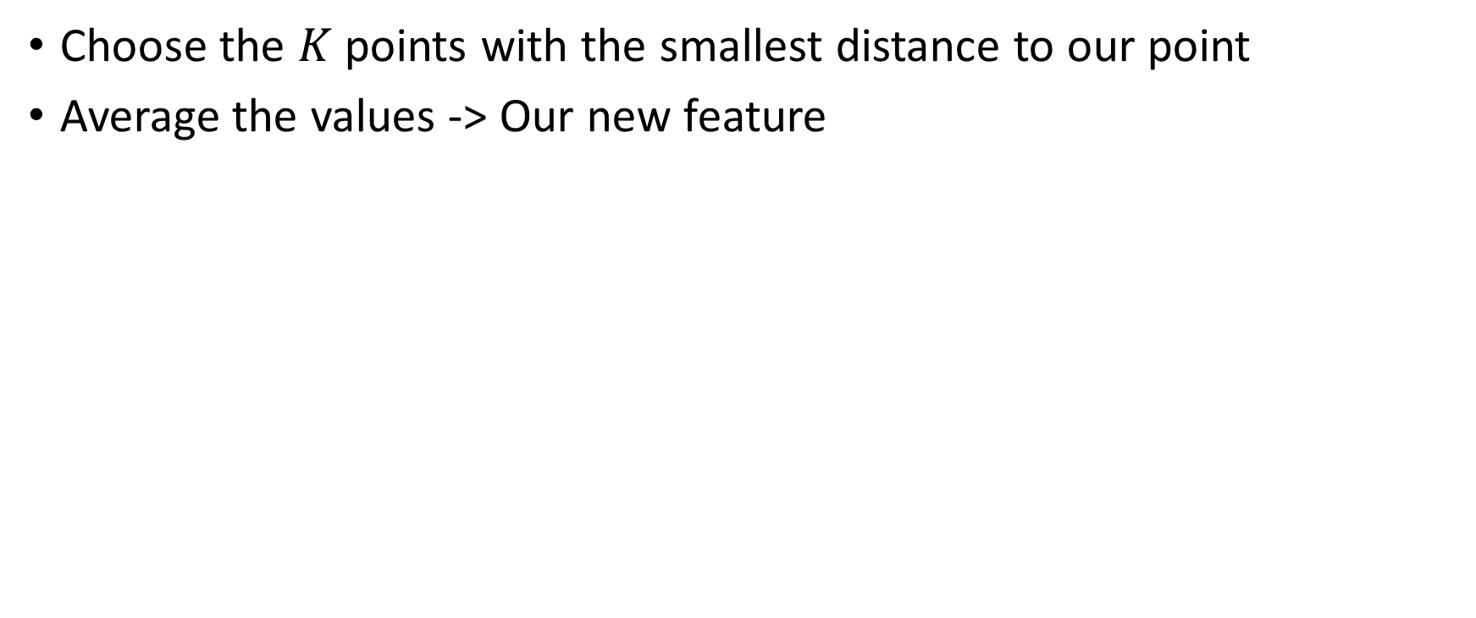
K-Nearest Neighbour
K-Nearest Neighbours Regressors
Choose the $K$ points with the smallest distance to our point
Average the values -> Our new feature
Inc_ angle

Slide 21
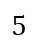
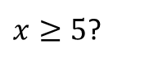
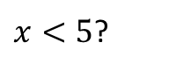
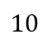
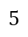
Decision Trees
Decision Trees
Split the data on a certain parameter(s), construct a tree
+
-
$x<5$?
$x≥5$?
-
+
-
+
+
$$5$$
-
-
$$5$$
$$10$$

Slide 22
Boosting
Boosting
Ensemble method to join many “weak” learners in order to take each of their strengths while overcoming their weaknesses
Each subsequent model works to improve the errors of the previous model
Notes:
Weak learner is a classifier that does just better than 50%

Slide 23
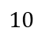
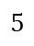
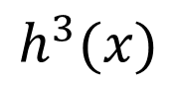
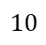
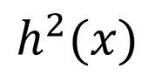
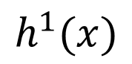
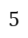
Boosting
Boosting
Boosting
+
-
+
-
+
-
-
-
-
+
+
+
+
+
+
$$5$$
$$5$$
$$5$$
-
-
-
-
-
-
$$5$$
$$10$$
$$5$$
$$10$$
$$5$$
$$10$$
$$h^{1}(x)$$
$$h^{2}(x)$$
$$h^{3}(x)$$
Notes:
2 out of 3
Dots are positive and X are negative
w(t+1) = w(t)/2 1/(1-e) correct
w(t+1) = w(t)/2 1/e incorrect

Slide 24
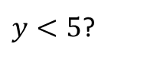
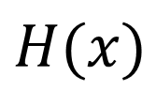
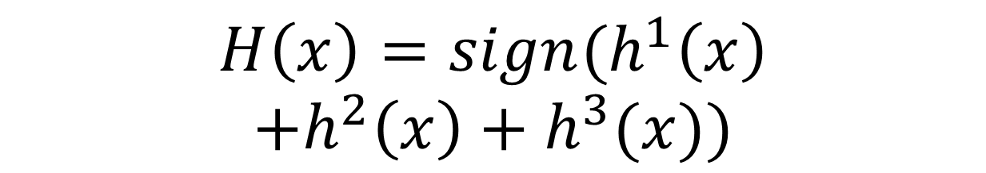
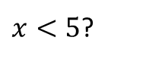
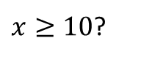
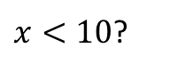
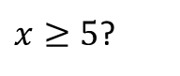
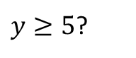
Boosting
Boosting
Boosting
$$H\left(x\right)=sign(h^{1}\left(x\right)$$
$$+h^{2}\left(x\right)+h^{3}(x))$$
+
-
-
+
+
$$5$$
$x<5$?
$x≥5$?
-
-
$$5$$
$$10$$
$y<5$?
$y≥5$?
$x<10$?
$x≥10$?
$$H(x)$$
-
+
-
+

Slide 25
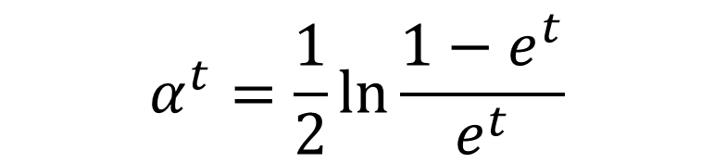
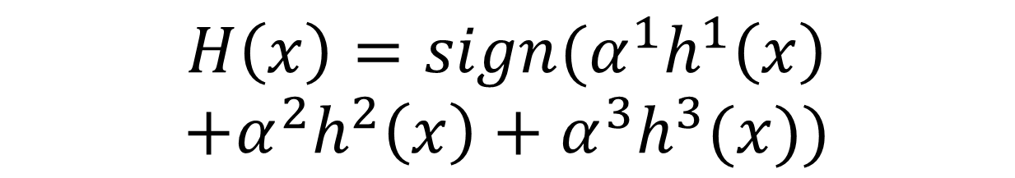
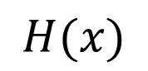
Boosting
Boosting
Boosting
$$H\left(x\right)=sign(α^{1}h^{1}\left(x\right)$$
$$+α^{2}h^{2}\left(x\right)+α^{3}h^{3}(x))$$
+
-
-
+
+
$$5$$
$$α^{t}=\frac{1}{2}\ln{\frac{1−e^{t}}{e^{t}}}$$
-
-
$$5$$
$$10$$
We can weight the models relative to the error.
$$H(x)$$

Slide 26
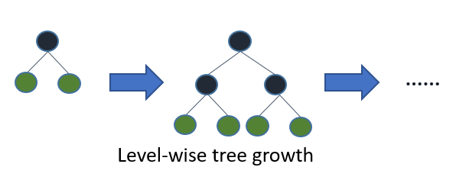
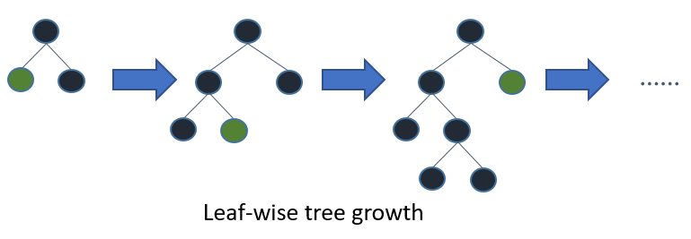
XGBoost vs. LightGBM
XGBoost vs. LightGBM
Boosting
XGBoost
LightGBM

Slide 27
XGBoost vs. LightGBM
XGBoost vs. LightGBM
Boosting
LightGBM
Faster training speed and higher efficiency
Lower Memory usage
Produces more complex trees -> Better Accuracy
Can lead to overfitting -> set max_depth
For large training sets, faster than XGBoost with equally accurate results
Notes:
Bucket continuous features

Slide 28
XGBoost vs. LightGBM
XGBoost vs. LightGBM
Boosting
If you’re ensembling many models: use both
If you’re constrained by time, memory or computing power, use LightGBM
Notes:
Bucket continuous features

Slide 29
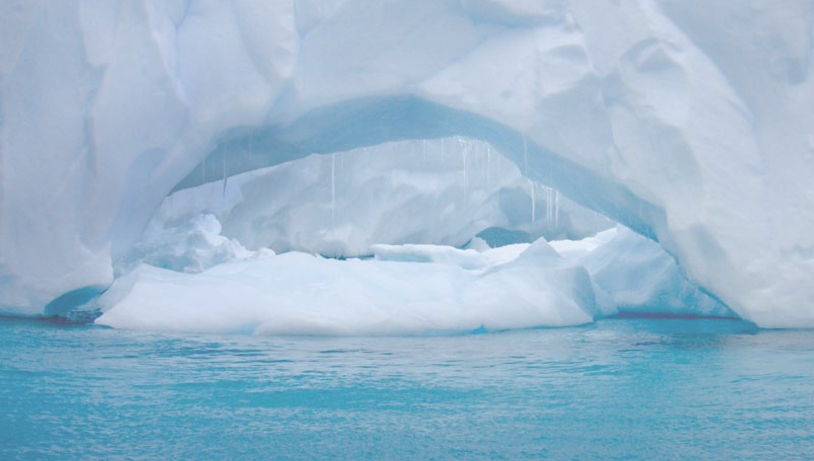
Solutions

Slide 30

1st Place Solution
Observations:
inc_angle with identical values (up to 4 decimal places) had the same label 97% of the time
Split dataset into two groups
Group 1 - inc_angle clusters of pure icebergs
Group 2 - inc_angle clusters of icebergs and ships (one dense iceberg surrounded by ships)

Slide 31

1st Place Solution
inc_angle

Slide 32
1st Place Solution
Notice the alternating pattern of natural groups
This pattern propagates throughout the entire dataset, and was found using KNN

Slide 33

1st Place Solution
Pipeline of 100+ diverse CNN models. Included customized CNNs, VGG, mini-GoogLeNet, Densenet, and more. Some included inc_angle in the Dense layer
Ensembled models
Applied a threshold for probabilities, such that if $p$ passed the threshold, the original label was kept (0 or 1)
Retrained 100+ CNNs on Group 2 only
Improvements in ship detection with better signal to noise
Public: 0.0801, Private: 0.0822

Slide 34
2nd Place Solution - CNN
Hundred of CNNs with fixed 5-fold Cross Validation on image data
Folds were based on inc_angle in order to avoid leakage
Did not train on images with missing inc_angle
Three families of models:
CNN trained from scratch on dual polarity images
Finetuned VGG16 with third channel (band1 + band2)/2
Double training set with pseudo-labelling (didn’t help)
Notes:
Mean_std, minimax, raw
Conv_dropout false, 0.1, 0.2
Dense droupout false 0.25 0.5
Alpha 0.00004 to 0.005

Slide 35
2nd Place Solution - CNN
Many weak learners and data augmentation
A lot of random parameter setting (preprocessing, conv_layers, dense_layers, conv_dropout, dense_dropout, learning rate, augmentation settings, optimization method)
Notes:
Mean_std, minimax, raw
Conv_dropout false, 0.1, 0.2
Dense droupout false 0.25 0.5
Alpha 0.00004 to 0.005

Slide 36
2nd Place Solution - XGBoost
Best N=5, 10, 15, 20 models for each fold were selected from each of the three model families
Train XGBoost on the following set of inputs
Perform parameter tuning on same CV split as in previous stage
Notes:
Random Parameter Search on various things

Slide 37
2nd Place Solution - XGBoost
Observations
Min, mean, geomean, median, max, std of previous predictions
inc_angle
Min, mean, median, max, std, quantiles of HH and HV
Distinct incident angle groups
Total count, train count, ship count, iceberg rate for each incident an
Min, mean, geomean, median, max, std
Notes:
Random Parameter Search on various things

Slide 38
2nd Place Solution - XGBoost
KNN
Incident angles
Mean prediction
Incident angle bins
Mean prediction
Total count, train count, iceberg count
Notes:
Random Parameter Search on various things

Slide 39

2nd Place Solution – Model Average
Retrained thousands of XGBoost with more conservative settings to avoid overfitting
Round all features to 3 decimal places
Minimum children $≥$ 3
Column sample $≤$ 0.5
Max tree depth in [3,4,5]
Switch off early stopping
95% model average of the 100 best XGBoost models
5% model average of the 100 best XGBoost models without inc_angle
Public: 0.0880, Private: 0.0855

Slide 40
3rd Place Solution
Trained 7 ANNs on images using 5-fold stacking and 30 stages
Each ANN had different architecture, data normalization and data augmentation
Mixed ANN predictions using XGBoost using 7-Fold stacking with 1000 stages
Notes:
7 ANN, stacking 5 folds and 30 repeats
Difference between ANNs were architecture, data norm/preprocessing, data augm.

Slide 41
3rd Place Solution
Spatial Model: Extracted neigbours from inc_angle
Object with no neighbours in some radius is ~90% a ship
Most icebergs/ice debris travel in clusters, whereas ships do not
Made predictions on new feature using XGBoost using 5-Fold stacking with 1000 repeats

Slide 42

3rd Place Solution
Two independent predictions:
$p_{1,i}$: ANNs mix based on image data
$p_{2,i}$: Spatial Model based on inc_angle
$$p_{i}= \frac{p_{1,i}p_{2,i}}{p_{1,i}p_{2,i}{ + (1−p}_{1,i}){(1−p}_{2,i})}$$
Public Score 0.0921, Private Score: 0.0871

Slide 43
3rd Place Solution
Trained 5 out of 7 ANNs with pseudo-labelling from previous predictions (no time for last 2)
Mixed ANN pseudo-labelling predictions using XGBoost (using stacking 7 fold and 1000 repeats)
Retrained Spatial Model using pseudo-labelling
Mixed above two predictions using previous formula for final prediction
Final Submission: Public 0.0893, Private 0.0857

Slide 44

4th Place Solution
Train 5 Convolutional Neural Networks (CNN) purely on image data
Excluded inc_angle
Used 5-Fold Cross Validation (CV5) with the same split for all models – chosen such that all validation scores were similar
Chose CNN model with best CV score
Notes:
Short recap of cross validation?

Slide 45
4th Place Solution
Group results by inc_angle for both test and train datasets
Calculate mean predictions, median predictions, and total samples
Run K-Nearest Neighbours regressors on best fold mean predictions and inc_angle
Train LightGBM model on the previous features
Total mean predictions, group mean and median predictions, total samples per group, KNN regressor
Notes:
Stressed the importance of Cross Validation anytime parameters are finetuned
LightGBM exploits the data leak

Slide 46

4th Place Solution
Finetune LightGBM based on CV from training data
Clip final probabilities
$p$ < 0.001 -> 0.001
$p$ > 0.999 -> 0.999
Notes:
Stressed the importance of Cross Validation anytime parameters are finetuned
LightGBM exploits the data leak

Slide 47
14th Place “Leaky Solution”
1st exploit:
If p > 0.5 and inc_angle in training set
p -> 0.999
Elif p < 0.5 and inc_angle in training set
p -> 0.001
Else
p
2nd exploit:
inc_angle not in training set, take majority rule of all predictions
Set p -> 0.999 or 0.001 accordingly

Slide 48
14th Place “Leaky Solution”
3rd exploit:
If inc_angle is in training set but prediction contradicts, take majority rule of predictions
Set p -> 0.001 or 0.999 accordingly
4th exploit:
0.001 -> 0.01 and 0.999 -> 0.99
Public: 0.1038, Private: 0.0960

Slide 49

Thank you
Q&A

